Slide 1
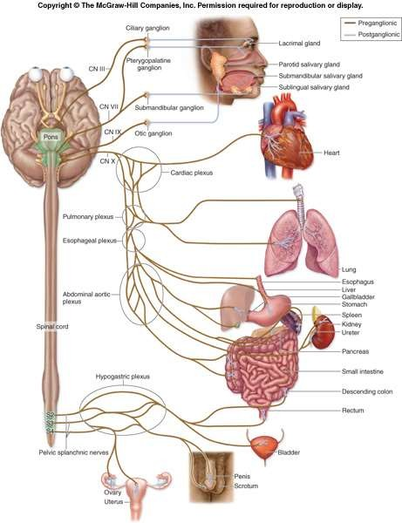
Human
Anatomy
Autonomic Nervous System
1

Slide 2
Autonomic Nervous System
◆ ANS
◆ complex system of nerves
◆ controls involuntary actions.
◆ Works with the somatic nervous system (SNS)
◆ regulates body organs
◆ maintains normal internal functions.
18-2

Slide 3
SNS, PNS, and ANS
◆ SNS and ANS are both part of the peripheral nervous system (PNS).
◆ SNS operates under our conscious control.
◆ ANS functions are involuntary.
18-3

Slide 4
Comparison of SNS and ANS
◆ SNS uses both somatic sensory and somatic motor neurons
◆ Somatic sensory neurons conduct stimulus information from a sensory receptor
◆ Somatic motor neurons innervate skeletal muscle fibers.
◆ ANS also utilizes sensory and motor neurons.
◆ Visceral sensory neurons provide input to activate the ANS
◆ Visceral motor neurons innervate smooth muscle,
cardiac muscle, and glands
18-4

Slide 5
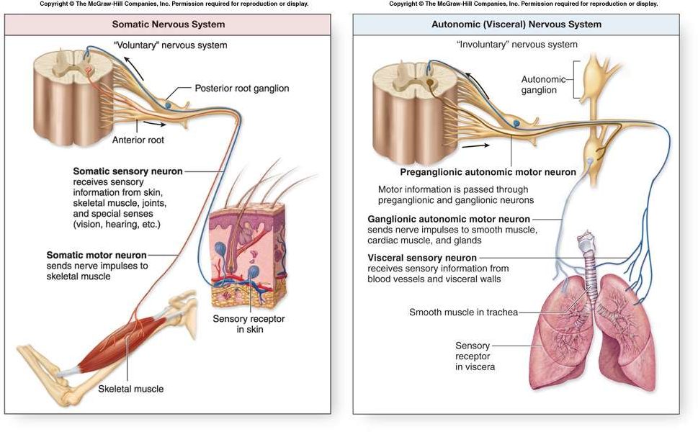
5

Slide 6
Neuron Chains in ANS
◆ Preganglionic neurons
◆ Before the ganglion
◆ Ganglion
◆ Synapse
◆ Grey matter
◆ Postganlionic neurons
◆ After the ganglion
18-6

Slide 7
Neuron Chains
◆ Neuronal convergence
◆ occurs when axons from numerous preganglionic cells
synapse (converge) on a single postganglionic cell.
◆ Neuronal divergence
◆ occurs when axons from one preganglionic cell synapse on numerous postganglionic cells
18-7

Slide 8
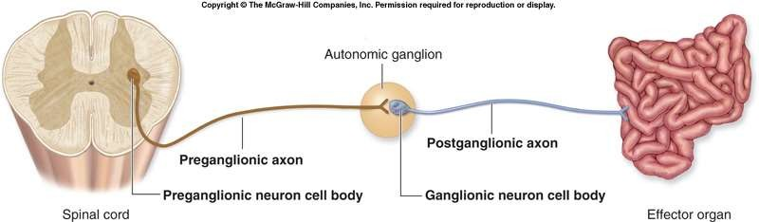
8

Slide 9
Divisions of the ANS
◆ Two divisions
◆ Parasympathetic division
◆ Sympathetic division
◆ Divisions are similar:
◆ both use a preganglionic neuron (cell body in the CNS)
◆ Both use a postganglionic neuron (cell body in the
ganglion)
◆ innervates muscles or glands.
◆ Both contain autonomic ganglia
◆ house the cell body of the preganglionic neurons.
◆ Both are involuntary
◆ Both are concerned with the body’s internal environment. (homeostasis)
◆ Divisions perform dramatically different¹⁸f⁻⁹unctions.

Slide 10
The Parasympathetic Division
◆ Also termed the craniosacral division.
◆ Primarily concerned with:
◆ conserving energy
◆ replenishing nutrient stores.
◆ Is most active when the body is at rest or digesting a meal.
◆ nicknamed the “rest-and-digest” division
◆ Works with the sympathetic division in maintaining homeostasis (a constant internal environment).

Slide 11
The Sympathetic Division
◆ Also termed the thoracolumbar division.
◆ Primarily concerned with preparing the body for emergencies.
referred to as the “fight-or-flight” division
◆ Increased sympathetic activity results in:
◆ increased alertness
◆ Increased metabolic activity

Slide 12
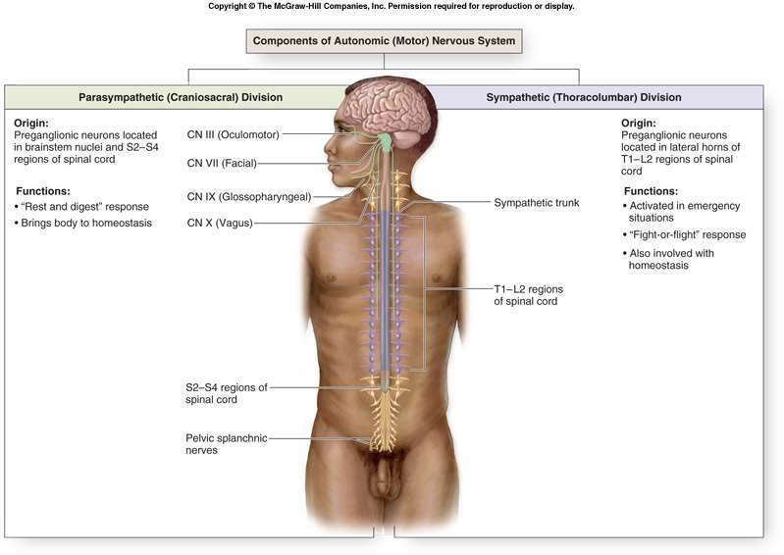
12

Slide 13
Anatomic Differences
◆ Divisions are distinguished by several anatomic differences.
◆ Preganglionic neuron cell bodies are housed in different regions of the CNS.
◆ Parasympathetic preganglionic neurons
originate in either:
◆ Brainstem
◆ lateral gray matter of the S2–S4 spinal cord regions.
◆ Sympathetic preganglionic neurons originate
in:
◆ lateral horns of the T1–L2 spinal cord regions
18-13

Slide 14
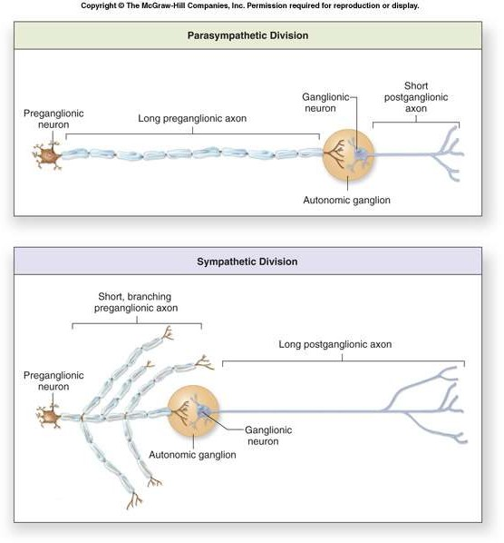
14

Slide 15
Anatomic Differences
◆ Parasympathetic division is structurally simple.
◆ Parasympathetic division is also termed the
craniosacral division because its preganglionic neurons are:
◆ housed within nuclei in the brainstem
◆ within the lateral gray regions of the S2–S4 spinal
cord segments.
◆ Postganglionic neurons in the parasympathetic division are found in
◆ terminal ganglia: are located close to the target organ
◆ intramural ganglia: located within the wall
of the target organ

Slide 16
Cranial Nerves:
parasympathetic division
◆ Associated with the parasympathetic division:
◆ the oculomotor (CN III)
◆ facial (CN VII)
◆ glossopharyngeal (CN IX)
◆ vagus (CN X)
◆ First three of these nerves convey parasympathetic
innervation to the head.
◆ Vagus nerve is the source of parasympathetic stimulation for:
◆ thoracic organs
◆ most abdominal organs.

Slide 17
Spinal Nerves: parasympathetic division
◆ Target organs innervated include:
◆ the distal portion of the large intestine
◆ the rectum
◆ most of the reproductive organs
◆ the urinary bladder
◆ the distal part of the ureter.
◆ Parasympathetic innervation causes
◆ increased smooth muscle motility (muscle contraction) and secretory activity in digestive tract organs
◆ contraction of smooth muscle in the bladder wall
◆ erection of the female clitoris and the male penis

Slide 18
18

Slide 19
Effects and General Functions of the Parasympathetic
Division
◆ Parasympathetic division is most active during times when the body must process nutrients and conserve energy.
◆ Lack of extensive divergence in preganglionic axons
◆ prevents the mass activation seen in the sympathetic division.
◆ Effects of the parasympathetic nervous system tend to be discrete and localized.
◆ Parasympathetic activity can affect one group of organs without necessarily having to “turn on” all other organs

Slide 20
Organization and Anatomy of the Sympathetic Division
◆ Much more complex than the parasympathetic division.
◆ Sympathetic preganglionic neuron cell bodies
◆ housed in the lateral horn of the T1–L2
◆ Preganglionic sympathetic axons:
◆ travel with somatic motor neuron axons
◆ exit the spinal cord
◆ enter first the anterior roots
◆ then the T1–L2 spinal nerves.
◆ Preganglionic sympathetic axons remain with the spinal nerve for a short distance
◆ they branch off and leave the spinal nerve

Slide 21
Left and Right Sympathetic Trunks
◆ Immediately anterior to the paired spinal nerves are the left
and right sympathetic trunks.
◆ Each is located immediately lateral to the vertebral column.
◆ A sympathetic trunk is like a pearl necklace:
◆ the “string” of the “necklace” is composed of bundles of axons
◆ the “pearls” are the sympathetic trunk (or paravertebral) ganglia
◆ house sympathetic ganglionic neuron cell bodies

Slide 22
Left and Right Sympathetic Trunks
◆ One sympathetic trunk ganglion is approximately associated with each spinal nerve.
◆ Cervical portions
◆ three sympathetic trunk ganglia
◆ superior, middle, and inferior cervical ganglia
◆ opposed to the eight cervical spinal nerves.

Slide 23
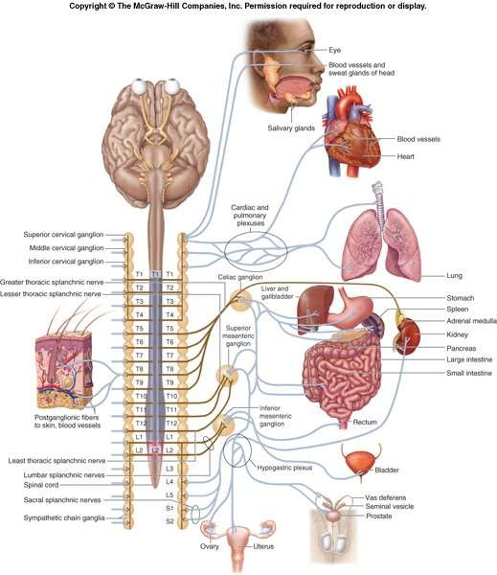
23

Slide 24
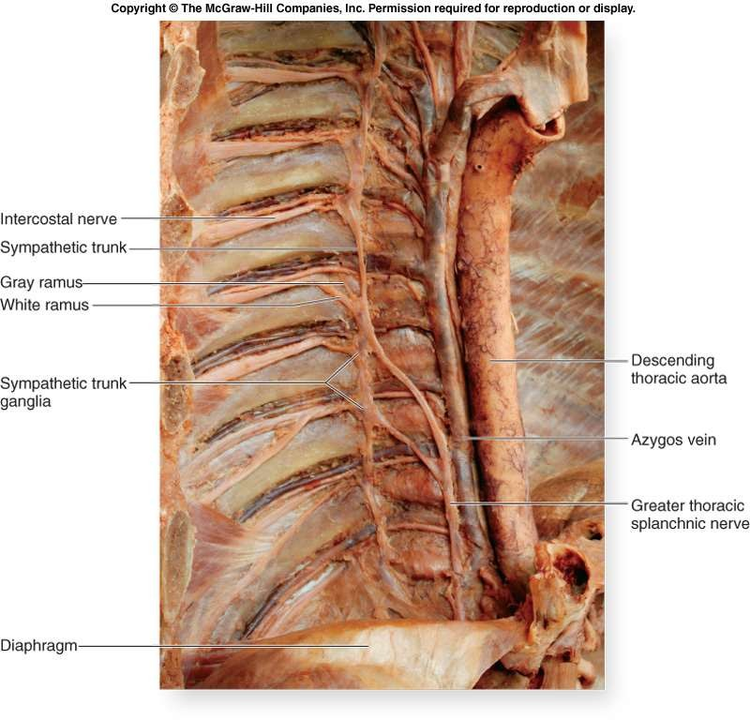
24

Slide 25
White Rami
◆ Connecting the spinal nerves to each sympathetic
trunk are rami communicantes.
◆ Carry preganglionic sympathetic axons from the T1–L2 spinal nerves to the sympathetic trunk.
◆ Associated only with the T1–L2 spinal nerves.
◆ Preganglionic axons are myelinated.
◆ the white ramus has a whitish appearance
◆ Similar to “entrance ramps” on a highway.

Slide 26
Gray Rami
◆ Carry postganglionic sympathetic axons
◆ from the sympathetic trunk to the spinal nerve.
◆ Axons are unmyelinated.
◆ gray rami have a grayish appearance
◆ Similar to “exit ramps” on a highway.
◆ Connect to all spinal nerves.
◆ Sympathetic information that starts in the thoracolumbar region can be dispersed to all parts of the body.

Slide 27
Splanchnic Nerves
◆ Composed of preganglionic sympathetic axons.
◆ Run anteriorly from the sympathetic trunk to most of
the viscera.
◆ Should not be confused with the pelvic splanchnic nerves associated with the parasympathetic division.
◆ Larger splanchnic nerves have specific names:
◆ greater thoracic splanchnic nerves
◆ lesser thoracic splanchnic nerves
◆ least thoracic splanchnic nerves
◆ lumbar splanchnic nerves
◆ sacral splanchnic nerves

Slide 28
Splanchnic Nerves
◆ Terminate in prevertebral (or collateral) ganglia.
◆ Called “prevertebral” because they are immediately anterior to the vertebral column.
◆ Prevertebral ganglia typically cluster around the major abdominal arteries and are named for these arteries.
◆ Example: celiac ganglia cluster around the celiac trunk
◆ Sympathetic postganglionic axons extend away from the ganglia and innervate many of the abdominal organs.

Slide 29
Types of Prevertebral Ganglia
◆ Differ from the sympathetic trunk ganglia.
◆ Are single structures, rather than paired.
◆ Are anterior to the vertebral column on the anterior surface of the aorta.
◆ Located only in the abdominopelvic cavity.
◆ Prevertebral ganglia include:
◆ the celiac ganglion
◆ superior mesenteric ganglion
◆ interior mesenteric ganglion.

Slide 30
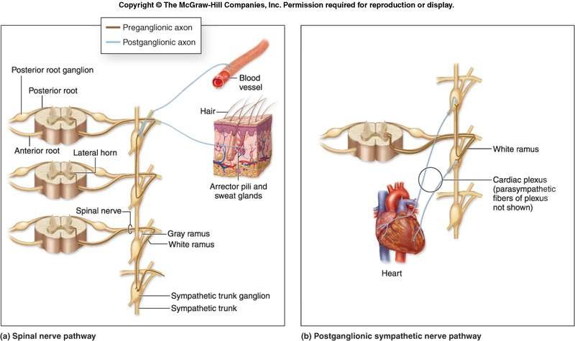
30

Slide 31
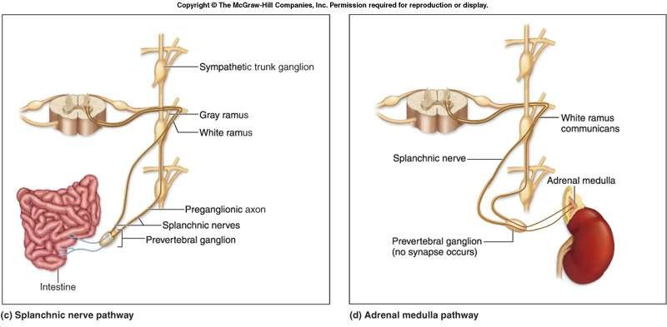
31

Slide 32
Sympathetic Pathways
◆ Spinal nerve pathway
◆ Postganglionic sympathetic nerve pathway
◆ The Splanchnic Nerve Pathway
◆ The Adrenal Medulla Pathway

Slide 33
Fight-or-Flight Function of the ANS
◆ May involve a single effector or many effectors.
◆ In mass activation, a large number of ganglionic neurons activate many effector organs.
◆ causes a heightened sense of alertness due to
stimulation of the reticular activation system

Slide 34
Dual Innervation by the Parasympathetic and Sympathetic
Divisions of the ANS
◆ Innervate organs through specific axon bundles
called autonomic plexuses.
◆ Communication by chemical messengers, called neurotransmitters.
◆ specific in each division of the autonomic nervous system
◆ Usually all organs are innervated by both divisions of the autonomic nervous system.
◆ Maintains homeostasis through autonomic reflexes that occur in the innervated organs.

Slide 35
Autonomic Plexuses
◆ Collections of sympathetic postganglionic axons and parasympathetic preganglionic axons, as well as some visceral sensory axons.
◆ Close to one another, but they do not interact or synapse with one another.
◆ Provide a complex innervation pattern to their target organs.

Slide 36
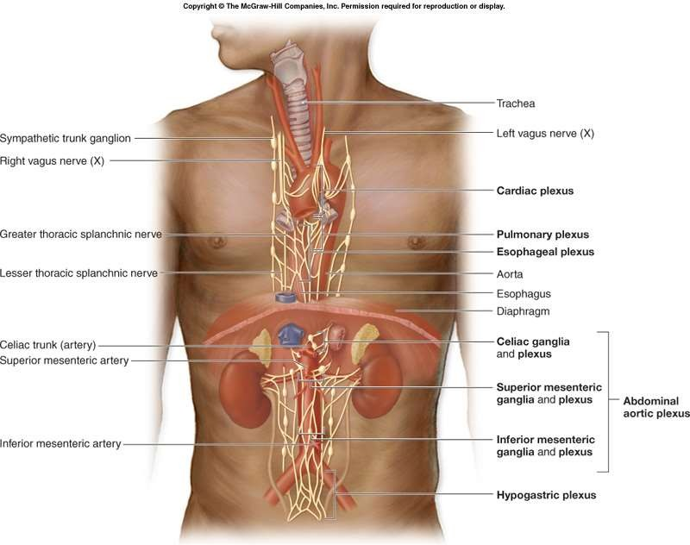
36

Slide 37
Plexuses
◆ Cardiac plexus
◆ increased sympathetic activity increases heart rate and
blood pressure, while
◆ increased parasympathetic activity decreases heart
rate
◆ Pulmonary Plexus
◆ parasympathetic pathway causes bronchoconstriction
and increased secretion from mucous glands of the
bronchial tree
◆ sympathetic innervation causes bronchodilation
◆ Esophageal Plexus
◆ parasympathetic axons control the swallowing reflex
◆ Abdominal aortic plexus
◆ consists of the celiac plexus, superior mesenteric
plexus, and inferior mesenteric plexus
◆ Hypogastric plexus

Slide 38
Neurotransmitters and Receptors
◆ Two neurotransmitters are used in the ANS.
◆ acetylcholine (ACh)
◆ norepinephrine (NE)
◆ Neurotransmitters are released by the presynaptic cell.
◆ Bind to specific receptors in the postsynaptic
cell membrane.
◆ Binding has either an excitatory or an inhibitory effect on the effector, depending on the specific receptor.

Slide 39
Neurotransmitters
◆ Both the preganglionic and postganglionic axons in the parasympathetic division release acetylcholine and thus are called cholinergic.
◆ The preganglionic axon and a few postganglionic axons in the sympathetic division are also cholinergic.
◆ Most of the postganglionic axons of the sympathetic division release norepinephrine and are called adrenergic.

Slide 40
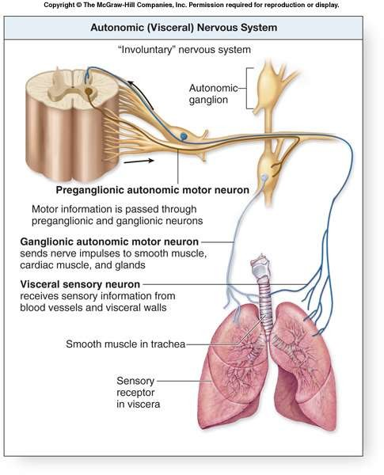
40

Slide 41
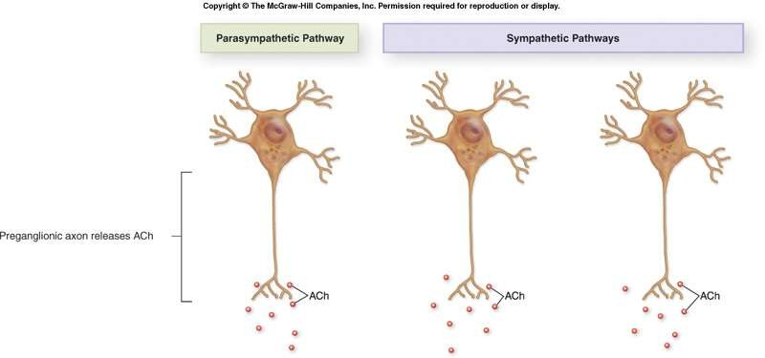
41

Slide 42
Dual Innervation
◆ Many visceral effectors are innervated by postganglionic axons from both ANS divisions.
◆ Actions of the divisions usually oppose each other.
◆ exert antagonistic effects on the same organ
◆ Opposing effects are also achieved by increasing or decreasing activity in one division.

Slide 43
Autonomic Reflexes
◆ ANS helps maintain homeostasis through the involuntary activity of autonomic reflexes or visceral reflexes.
◆ Consist of smooth muscle contractions, cardiac muscle contractions, or secretion by glands that are mediated by autonomic reflex arcs in response to a specific stimulus.
◆ Example: micturition reflex, which partly controls the release of urine
◆ Other reflexes include alteration of heart rate, changes in respiratory rate and depth, regulation of digestive system activities, and alteration of pupil diameter.
◆ Comparable to spinal reflexes.
◆ Classic autonomic reflex involves the reduction of blood pressure.

Slide 44
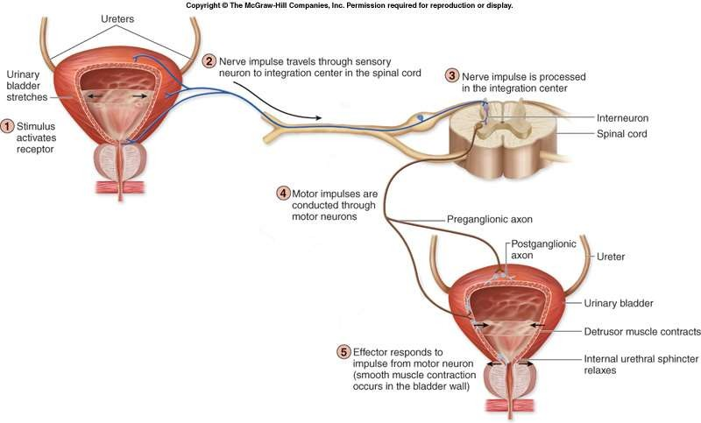
44

Slide 45
CNS Control of Autonomic Function
◆ Autonomic function is influenced by the
cerebrum, hypothalamus, brainstem, and
spinal cord.
◆ Sensory processing in the thalamus and
emotional states controlled in the limbic system directly affect the hypothalamus.
◆ the integration and command center for autonomic functions
◆ contains nuclei that control visceral functions in both divisions of the ANS
◆ communicates with other CNS regions, including the cerebral cortex, thalamus, brainstem, cerebellum, and spinal cord

Slide 46
CNS Control of Autonomic Function
◆ The hypothalamus is the central brain structure involved in emotions and drives that act through the ANS.
◆ The brainstem nuclei in the mesencephalon, pons, and
medulla oblongata mediate visceral reflexes.
◆ Reflex centers control accommodation of the lens, blood pressure changes, blood vessel diameter changes, digestive activities, heart rate changes, and pupil size.
◆ The centers for cardiac, digestive, and vasomotor functions
are housed within the brainstem.
◆ Some responses (defecation and urination), are processed and controlled at the level of the spinal cord without the involvement of the brain.
◆ Higher centers in the brain may consciously inhibit these reflex activities.

Slide 47
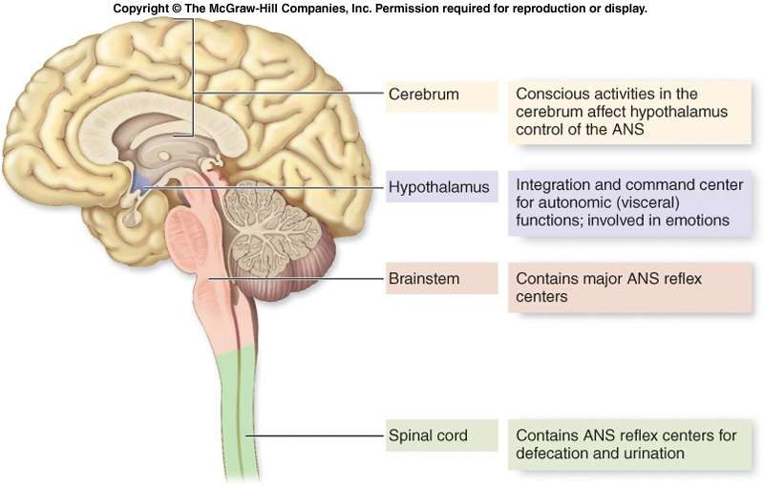
47

